Slide 1

DATA ENGINEERING 1
INTRO
Laszlo Sallo
SEPTEMBER 2021

Slide 2

WHO DO YOU WANT BE (OR NOT TO BE)?

Slide 3
THE DATA SCIENTIST
STATISTICIAN
DATA MINER
PREDICTIVE ANALYST
BUSINESS
ANALYST
DATA SCIENTIST
(ENTERPRISE)
DATA ANALYST
BUSINESS
SCIENCE

Slide 4
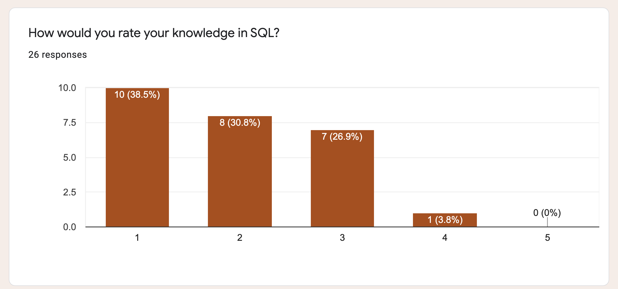
SQL KNOWLEDGE

Slide 5
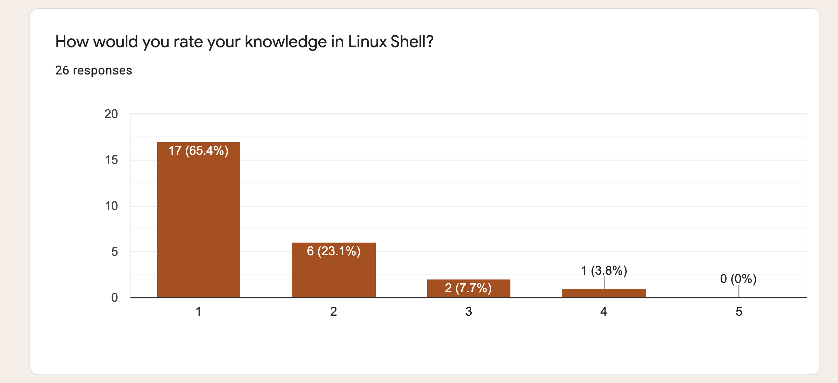
LINUX SHELL

Slide 6
COURSE SUMMARY – PART1
MANIPULATING DATABASE
WITH SQL USING MYSQL AS
RELATIONAL DATABASE MANAGEMENT SYSTEM

Slide 7

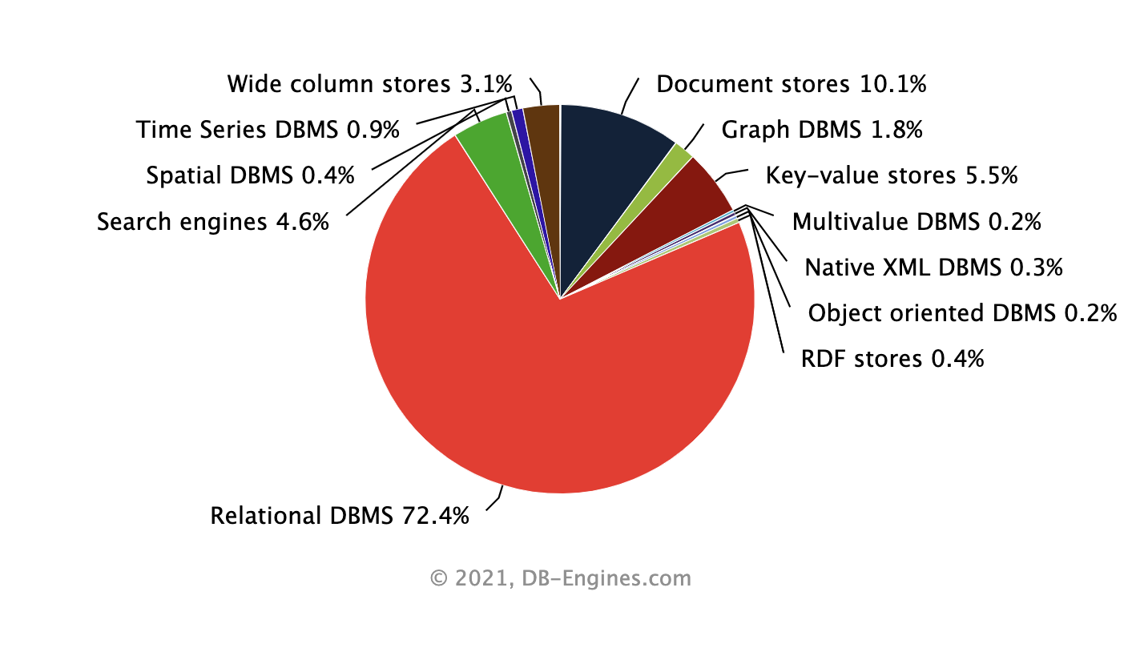
WHY?

Slide 8
SQL IN 5 MINUTES
IN A CHROME BROWSER
GOOGLE
The Try-SQL Editor

Slide 9




BOOKS & OTHER MATERIALS
https://www.w3schools.com/sql/sql_intro.asp
https://dev.mysql.com/doc/refman/8.0/en/
https://www.mysqltutorial.org/

Slide 10
COURSE KNOWLEDGE BASE
CEU Moodle
GIT
https://ceulearning.ceu.edu
https://ceu-economics-and-business.github.io/ECBS-5146-Different-Shapes-of-Data/

Slide 11


ENVIRONMENT TO SETUP
+

Slide 12
EVALUATION AND EXPECTATIONS
Course participation (10%)
Term Project 1 (40%)
Term Project 2 (50%)
Intellectual contribution aka BE PRESENT
HELP each other
Do not DESPAIR, ask for help
DO the extra mile

Slide 13

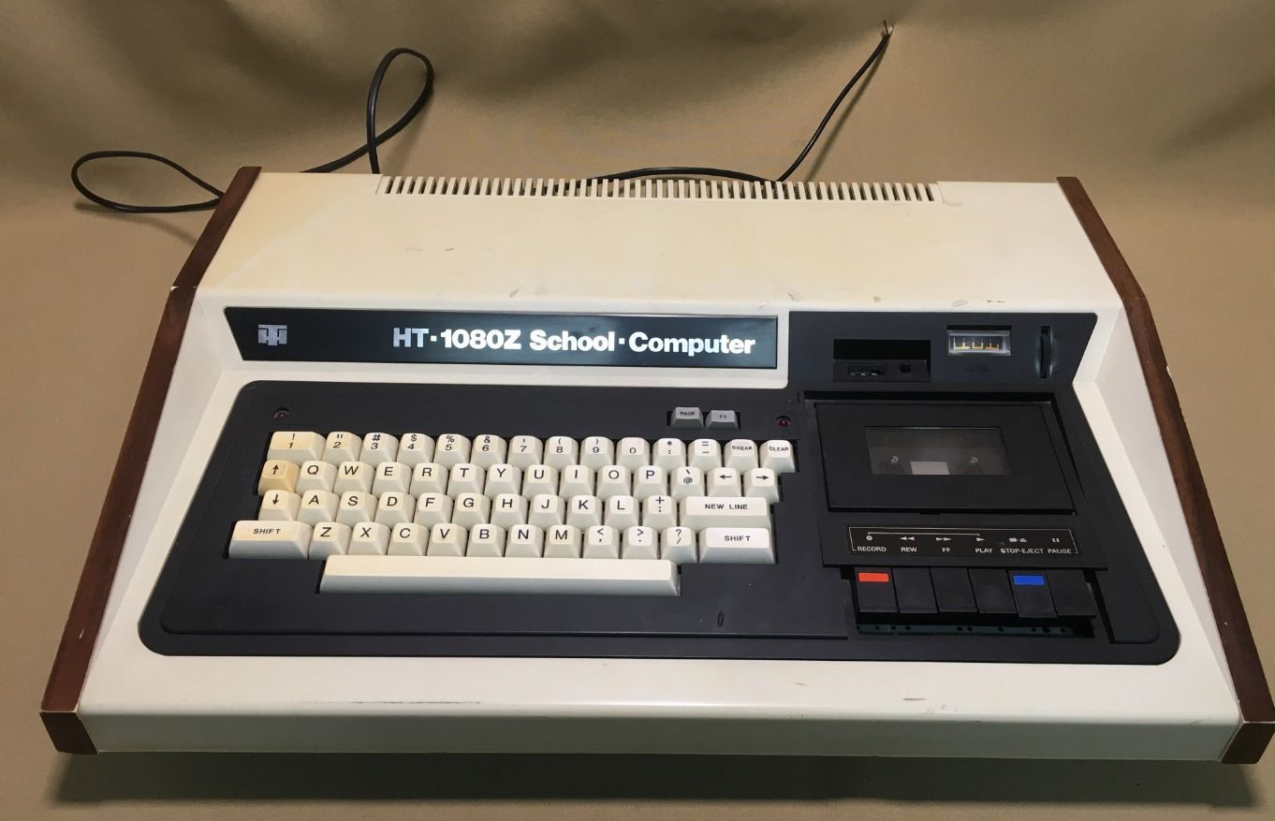


ABOUT ME
LASZLO SALLO (Head of an Offshore Development Center)
LinkedIn: https://www.linkedin.com/in/laszlosallo
Mail: sallol@ceu.edu

Slide 14



STUDENT SUPPORT
Teaching assistant: Sandor Budai (BudaiS@ceu.edu)
Communication: email or slack (de1-2021 channel on ceu-bizanalytics)
Tutoring: on demand, afternoons on Zoom

Slide 15
PRESSING QUESTIONS OF CHAPTER 1
What is SQL?
What is a Relational Model?
What is a Relational Database?
What is RDBMS?
What is MySQL?
Difference between MySQL and other RDBMS?

Slide 16
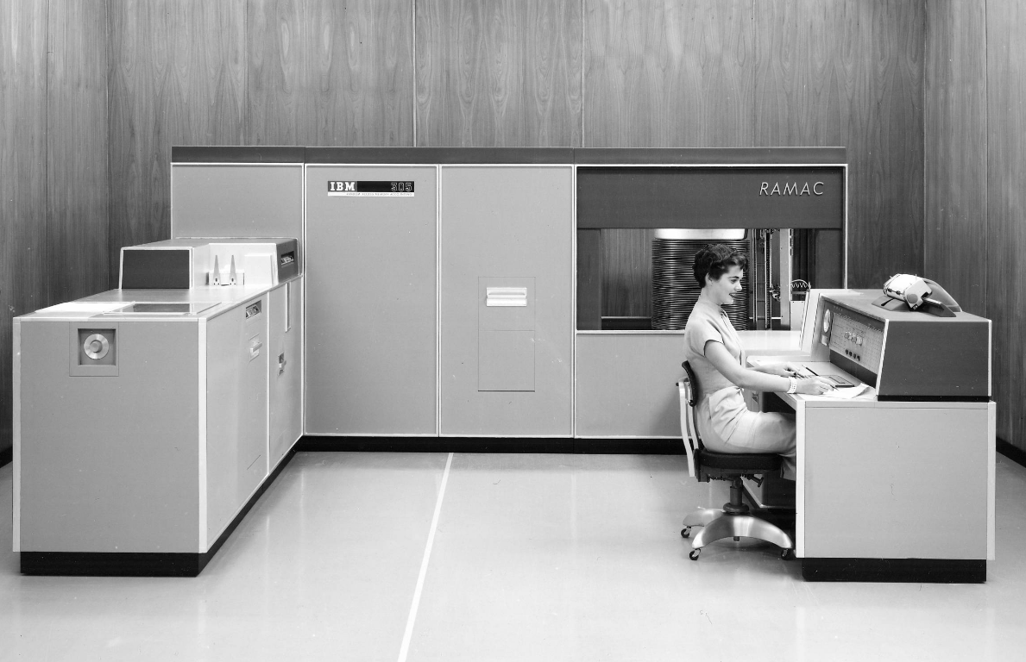
THE HISTORY OF DIGITAL PERSISTENCY

Slide 17
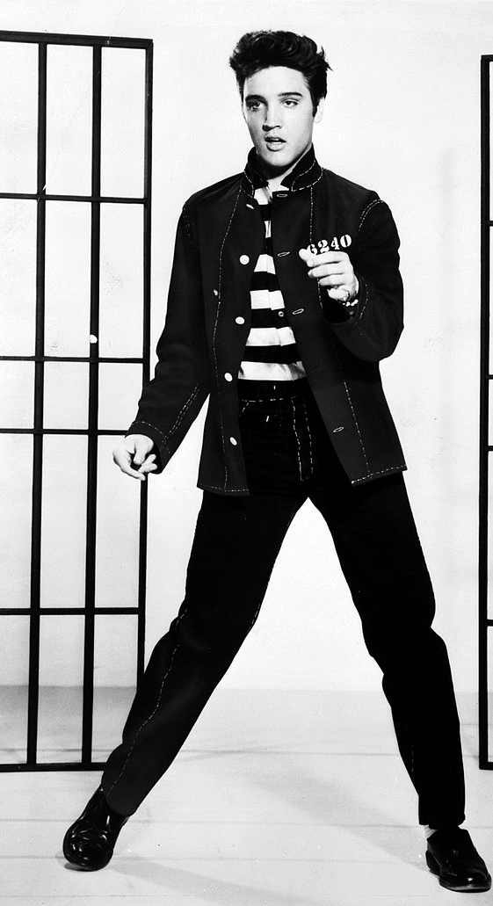
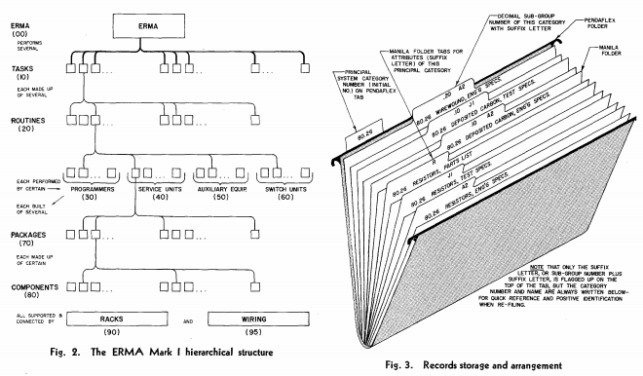
50’s FILE SYSTEM ROCKS!

Slide 18

60’s DATABASE FOR PEOPLE
Database Management Systems:
Simultaneous access to data
Security / User management
Administration
Unified access interface

Slide 19
TABULAR
TABLE
COLUMN or FIELD
HR_EVENTS
ID | DATE | NAME | EMAIL | OPERATION | TITLE | TITLE_REFID
1 | 2015.05.09 | John | john@company.com | join | Junior Analyst | 34
2 | 2017.05.10 | Kate | kate@company.com | promotion | Senior Analyst | 67
3 | 2017.05.10 | John | john@company.com | departure | Senior Analyst | 67
4 | 2017.05.11 | Mary | mary@company. com | join | Lead Analyst | 23
ROW or RECORD

Slide 20
RELATIONAL
EVENT
PRIMARY KEY
ID | DATE | EMPLOYEE_ID | OPERATION | TITLE_ID
1 | 2017.05.09 | 1 | join | 3
2 | 2017.05.10 | 2 | promotion | 2
3 | 2017.05.10 | 1 | departure | 2
4 | 2017.05.11 | 4 | join | 1
EMPLOYEE
ID | NAME | EMAIL
1 | John | john@company.com
2 | Kate | kate@company.com
4 | Mary | mary@company.com
FOREIGN KEY
TITLE
ID | TITLE | TITLE_REFID
1 | Lead Analyst | 23
2 | Senior Analyst | 67
3 | Junior Analyst | 34

Slide 21
DATABASE NORMALIZATION
The process of organizing the columns and tables of a database to reduce data redundancy and improve data integrity.

Slide 22
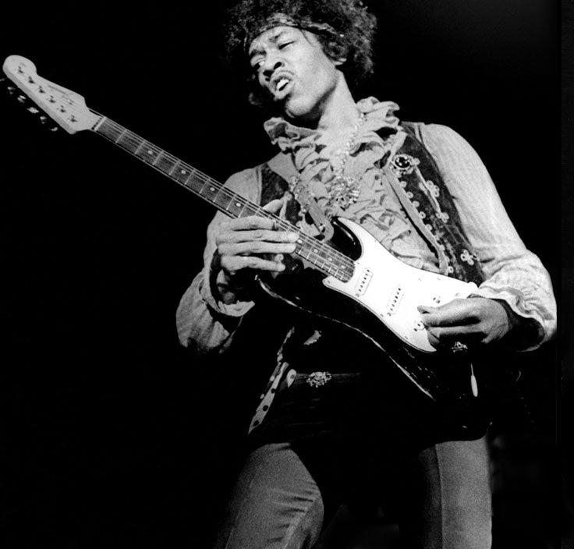
70’s HIT: THE RDBMS
Relational Database Management System
A digital database using the relational model of data for storing data

Slide 23

80’s DISCO: SQL RDBMS
Structured Query Language
is a language
designed to interact (“talk”) with a database.
“Find all customers”
“Add a new product”
“Delete orders”
Standardized but multiple dialects.
Once you learn on dialect,
you can easily switch to another

Slide 24
SQL EXAMPLE
EVENT
ID | DATE | EMPLOYEE_ID | OPERATION | TITLE_ID
1 | 2017.05.09 | 1 | join | 3
2 | 2017.05.10 | 2 | promotion | 2
3 | 2017.05.10 | 3 | departure | 2
4 | 2017.05.11 | 4 | join | 1
SELECT TITLE_ID FROM EVENT WHERE ID=3
TITLE_ID
2

Slide 25



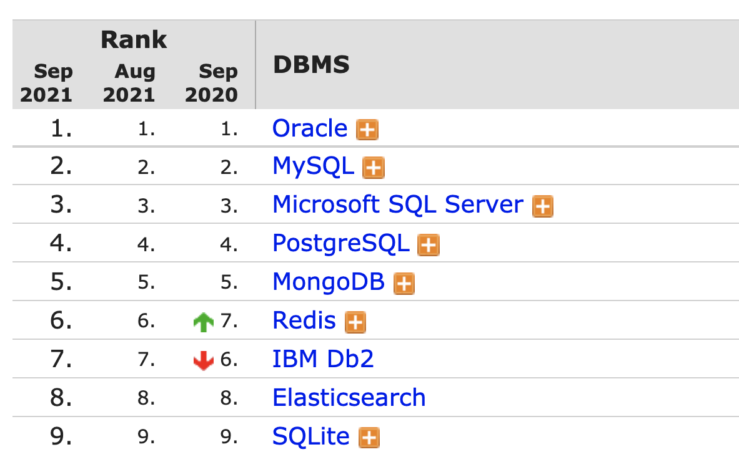

SQL MONOPOLY 1980-2010

Slide 26
MYSQL VS …
Available for free
Most widespread RDBMS
Does not strives to be 100% standard SQL compliant
Less strong in enterprise features, yet not lightweight
MORE:
https://www.keycdn.com/blog/popular-databases

